Slide 1
CS 316: Introduction to Deep Learning
Language Models - RNN
Dr Abdul Samad

Slide 2

Modeling Language
Aab cmde kkkkk !..
https://picsart.com/
Notes:
In Section 9.2, we saw how to map text sequences into tokens, where these tokens can be viewed as a sequence of discrete observations such as words or characters. Assume that the tokens in a text sequence of length � are in turn �1,�2,…,��. The goal of language models is to estimate the joint probability of the whole sequence:
(9.3.1)�(�1,�2,…,��),
where statistical tools in Section 9.1 can be applied.
Language models are incredibly useful. For instance, an ideal language model should generate natural text on its own, simply by drawing one token at a time ��∼�(��∣��−1,…,�1). Quite unlike the monkey using a typewriter, all text emerging from such a model would pass as natural language, e.g., English text. Furthermore, it would be sufficient for generating a meaningful dialog, simply by conditioning the text on previous dialog fragments. Clearly we are still very far from designing such a system, since it would need to understand the text rather than just generate grammatically sensible content.

Slide 3


Learning Language Models
Assume tokens as word
Estimating it
Notes:
. Suppose that we tokenize text data at the word level.
. The number of all unique tokens are called vocabulary
. Estimation becomes very difficult task when the T grows, because we may not have n-grams

Slide 4
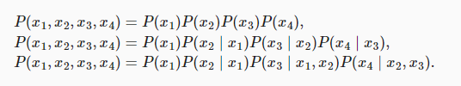
Markov models
Unigram, bigram, trigram

Slide 5
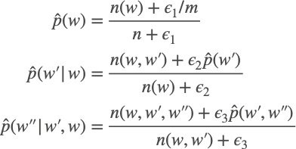
N-grams (longer sequences of tokens)
Need smoothing (long n-grams are infrequent)
Notes:
Unfortunately, models like this get unwieldy rather quickly for the following reasons. First, as discussed in Section 9.2.5, many n-grams occur very rarely, making Laplace smoothing rather unsuitable for language modeling. Second, we need to store all counts. Third, this entirely ignores the meaning of the words. For instance, “cat” and “feline” should occur in related contexts. It is quite difficult to adjust such models to additional contexts, whereas, deep learning based language models are well suited to take this into account. Last, long word sequences are almost certain to be novel, hence a model that simply counts the frequency of previously seen word sequences is bound to perform poorly there.
Denote by n the total number of words in the training set and m the number of unique words.

Slide 6

Perplexity
3 sentences generated by the models
“It is raining outside”
“It is raining banana tree”
“It is raining piouw;kcj pwepoiut”
Always predicts correct or wrong or uniform distribution?
Notes:
where P is given by a language model and xt is the actual token observed at time step t from the sequence.
In the best case scenario, the model always perfectly estimates the probability of the target token as 1. In this case the perplexity of the model is 1.
In the worst case scenario, the model always predicts the probability of the target token as 0. In this situation, the perplexity is positive infinity.
At the baseline, the model predicts a uniform distribution over all the available tokens of the vocabulary. In this case, the perplexity equals the number of unique tokens of the vocabulary. In fact, if we were to store the sequence without any compression, this would be the best we could do to encode it. Hence, this provides a nontrivial upper bound that any useful model must beat.

Slide 7
Text Preprocessing

Slide 8
Neural Net Classification with embeddings as input features!

Slide 9
Neural Language Models (LMs)
Language Modeling: Calculating the probability of the next word in a sequence given some history.
We've seen N-gram based LMs
But neural network LMs far outperform n-gram language models
State-of-the-art neural LMs are based on more powerful neural network technology like Transformers
But simple feedforward LMs can do almost as well!

Slide 10
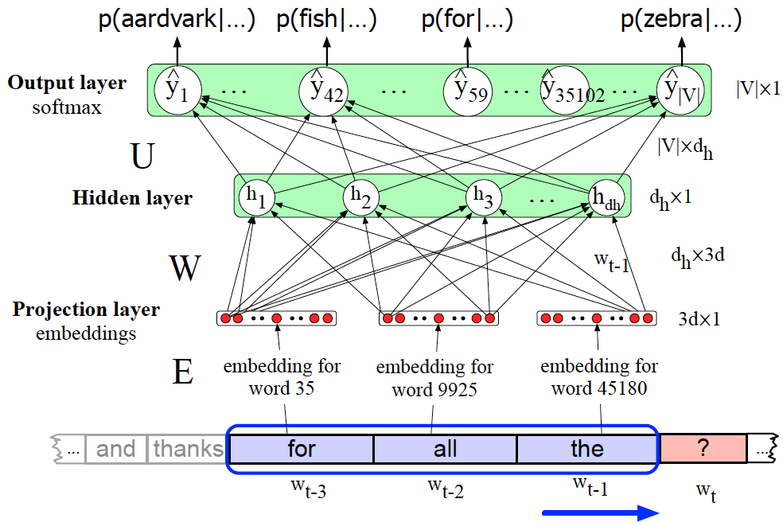
Neural Language Model
Notes:
Here's a sketch of this simplified feedforward neural language model with N=3; we have a moving window at time t with an embedding vector representing each of the 3 previous words (words wt−1, wt−2, and wt−3). These 3 vectors are concatenated together to produce x, the input layer of a neural network whose output is a softmax with a probability distribution over words. Thus y42, the value of output node 42 is the probability of the next word wt being V42, the vocabulary word with index 42.

Slide 11
Tokenization
Basic Idea - map text into sequence of IDs
Character Encoding (each character has one ID)
Small vocabulary
Doesn’t work so well
Word Encoding (each word has one ID)
Accurate spelling
Doesn’t work so well
Byte Pair Encoding (Goldilocks zone)
Frequent subsequences (like syllables)

Slide 12
Encoding
Character Encoding
Byte Pair Encoding
Character | Character ID
'A' | 1
'r' | 2
't' | 3
'i' | 4
'f' | 5
'i' | 4
'c' | 6
'i' | 4
'a' | 7
'l' | 8
Subword | Subword ID
'Art' | 1
'ificial' | 2
' ' (space) | 3
'intelligence' | 4
' ' (space) | 3
'is' | 5
' ' (space) | 3
'changing' | 6
' ' (space) | 3
'the' | 7
' ' (space) | 3
'world' | 8
'.' | 9
Word Encoding
Word | Word ID
'Artificial' | 1
'intelligence' | 2
'is' | 3
'changing' | 4
'the' | 5
'world' | 6

Slide 13
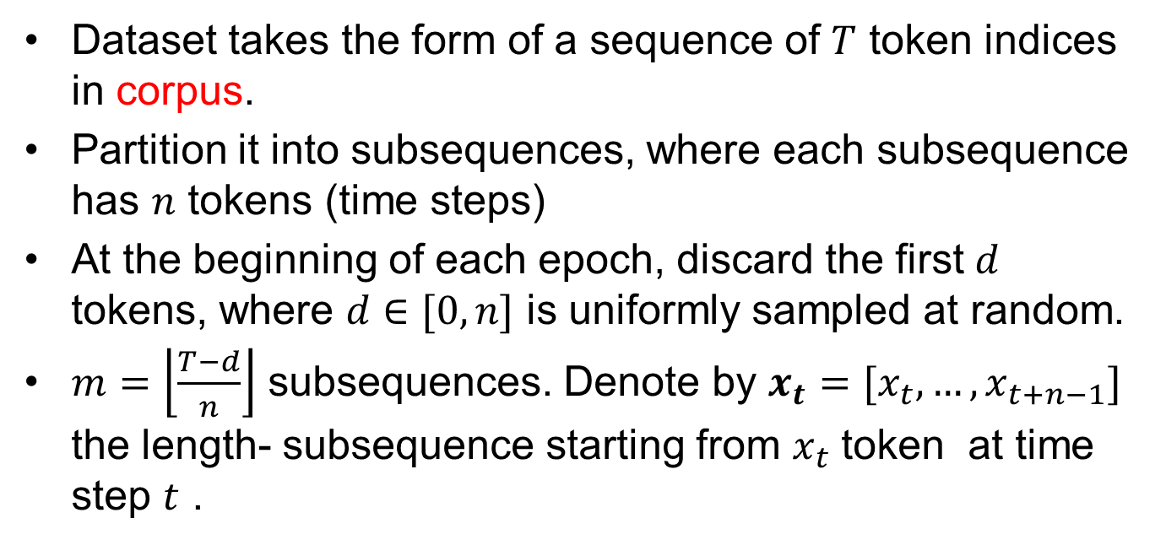
Partitioning sequences

Slide 14
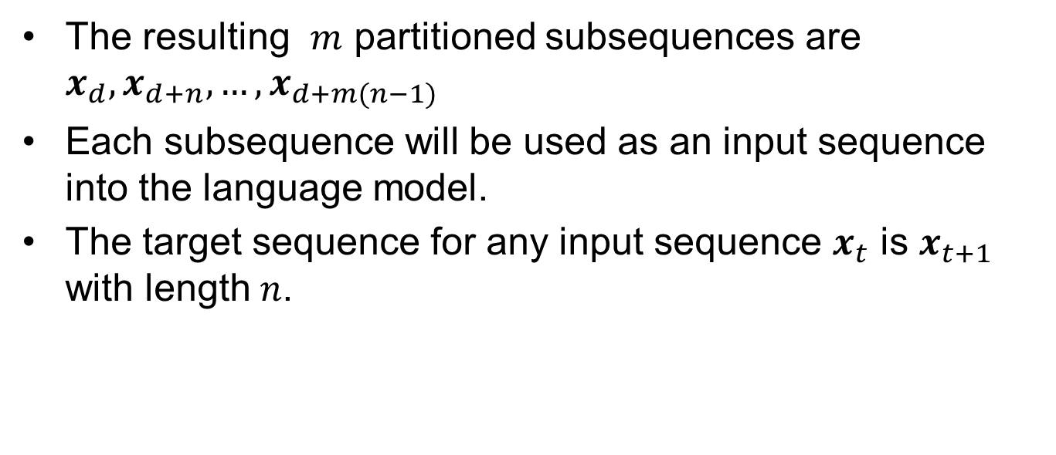
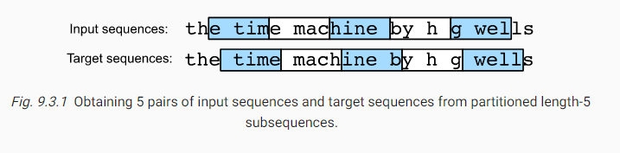
Partitioning sequences

Slide 15

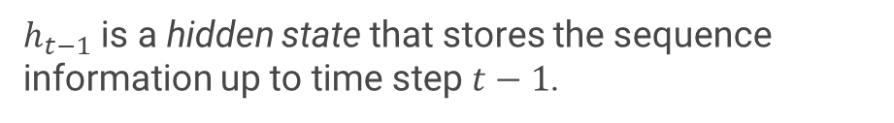

RNN
Notes:
If we want to incorporate the possible effect of tokens earlier than time step t−(n−1) on xt, we need to increase n. However, the number of model parameters would also increase exponentially with it, as we need to store |V|n numbers for a vocabulary set V. Hence, rather than modeling P(xt∣xt−1,…,xt−n+1) it is preferable to use a latent variable model:
ht−1 is a hidden state that stores the sequence information up to time step t−1.

Slide 16
Recurrent Neural Networks (with hidden state)
Hidden State update
Observation update

Slide 17
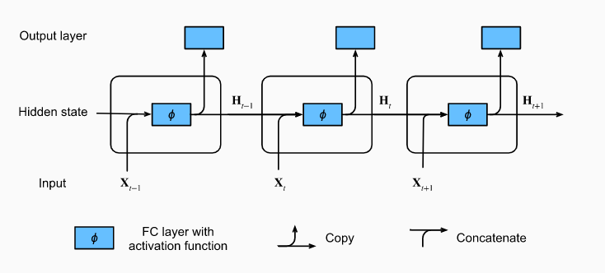
RNN

Slide 18
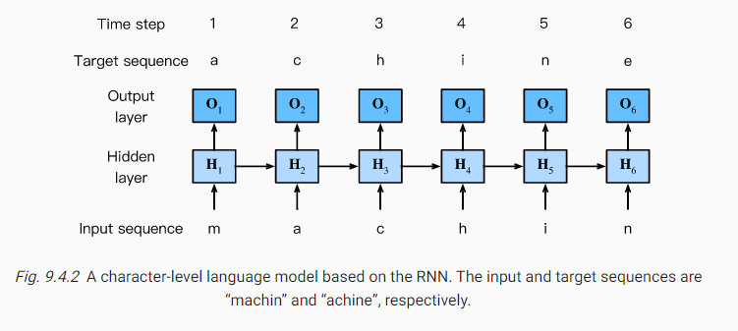
Character Level RNN

Slide 19
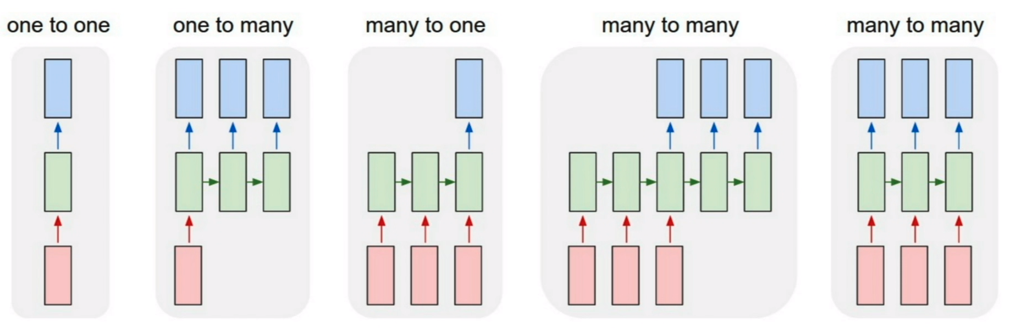
Types of RNN (Andrej Kerpathy Blog)

Slide 20
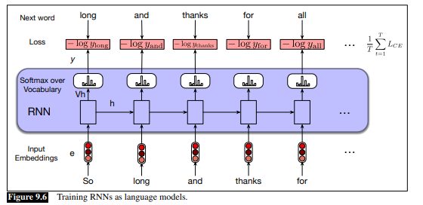

Slide 21
Training a Language Model
Notes:
Self supervision: We are not tagging the sequence and the sequence itself is helping for the next word prediction.
Teacher Forcing

Slide 22
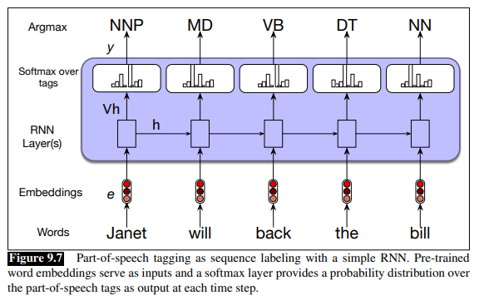
Sequence Labeling

Slide 23
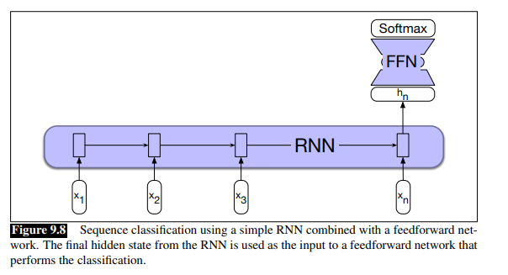
Sequence Classification

Slide 24
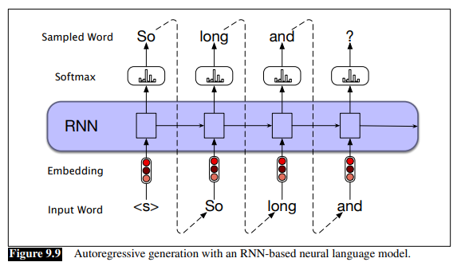
Autoregressive generation
Notes:
Sample a word in the output from the softmax distribution that results from using the beginning of sentence marker, , as the first input.
• Use the word embedding for that first word as the input to the network at the next time step, and then sample the next word in the same fashion.
• Continue generating until the end of sentence marker, , is sampled or a fixed length limit is reached.

Slide 25
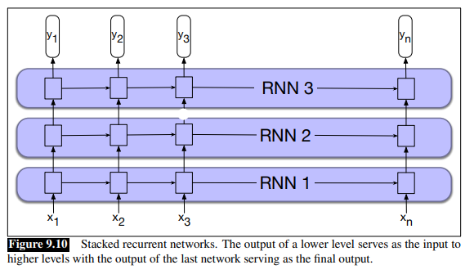
Stacked RNNs

Slide 26
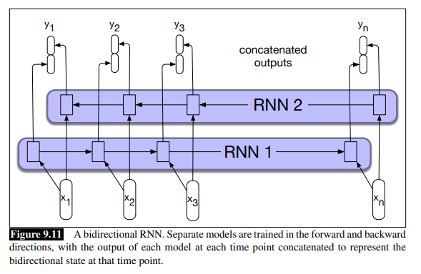
Bidirectional RNN

